Slide 1
Do machines know the meaning of a word?
Hung-yi Lee
Notes:
Preparing the demo
Extra topic:
maybe I can talk about relation extraction
Rest:
Paragraph vector
Introducing document vector
convolutional DSSM or parsing tree
Introducing the whole representation
Topic covered:
Motivation: meaning representation
Meaning of one word:
predict the next word
structure
How to train 1
why? What we get (done)
other structure 1
Meaning of a sentence:
Deep Semantic 1
+ convolution 1
Paragraph Vector 1
Outlook: parsing, composition

Slide 2



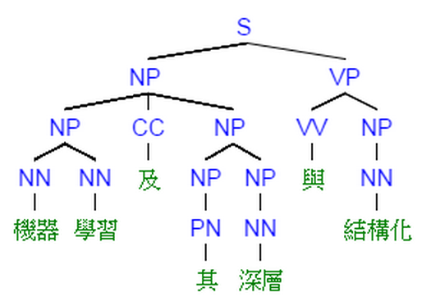



Language Technology
spam detection
Sentiment Analysis
Retrieval
這部電影太糟了
Negative (負雷)
(http://spam-filter-review.toptenreviews.com/)
Translation
Speech Recognition
Part-of-speech Tagging
“Machine learning ……”
John saw the saw.
大家好……
“機器學習 ……”
PN V D N
Syntactic Analysis
Summarization
Name Entity Recognition
這 位 是 李 宏 毅
Name of People
document
summary
Notes:
http://naviglinlp.blogspot.tw/2015/03/lecture-1-introduction.html
Searle'sChinese Room argument.

Slide 3
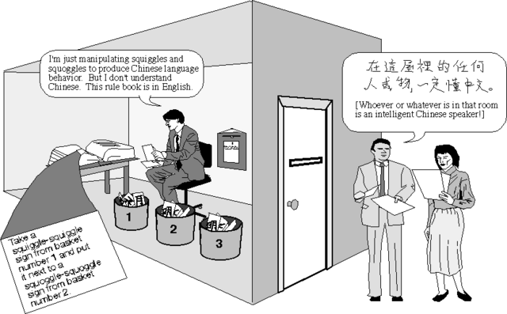
Do machine really understand human language?
http://cse3521.artifice.cc/chinese-room.html

Slide 4
Meaning Representation
Do machine know the meaning of a word or word sequence?
tree
flower
the animals with four legs
dog
rabbit
run
jump
cat

Slide 5
Meaning of Word

Slide 6
Fill in the Blank
……
有
一種
哈密瓜
_____
味
w_{i-3}
w_{i-2}
w_{i-1}
w_{i}
Neural
Network
Input: the previous words w_{i-1}, w_{i-2}, w_{i-3}
Output: the most possible next word w_{i}
Each word should be represented as a feature vector.
Notes:
Any application?
Describe latter
Given a sequence of words, predict the next word

Slide 7
Fill in the Blank
1-of-N Encoding
lexicon = {apple, bag, cat, dog, elephant}
apple = [ 1 0 0 0 0]
The vector is lexicon size.
bag = [ 0 1 0 0 0]
Each dimension corresponds to a word in the lexicon
cat = [ 0 0 1 0 0]
dog = [ 0 0 0 1 0]
The dimension for the word is 1, and others are 0
elephant = [ 0 0 0 0 1]
Notes:
Can be very large

Slide 8
Fill in the Blank
…… w_{i-2} w_{i-1} ___
0
The probability for each word as the next word w_{i}
1
w_{i-2}
lexicon size
0
……
Neural
Network
P(w_{i}=“apple”)
P(w_{i}=“bag”)
P(w_{i}=“cat”)
0
P(w_{i}=“dog”)
0
w_{i-1}
lexicon size
P(w_{i}=“elephant”)
1
……
Output layer: Softmax
lexicon size
Notes:
Which layer, how many

Slide 9
Fill in the Blank
Training:
哈密瓜
Neural
Network
一種
Collect data:
有
哈密瓜 有 一種 哈 味
不爽 不要 買
公道價 八萬 一
………
有
Neural
Network
哈
一種
Minimizing cross entropy
一種
Neural
Network
味
哈
Notes:
What can it do? Application?

Slide 10
Word Vector
0
z₁
1-of-N encoding
of the word w_{i-1}
1
z₂
The probability for each word as the next word w_{i}
0
……
……
…
……
Take out the input of the neurons in the first layer
z₂
tree
flower
Use it to represent a word w
dog
rabbit
run
jump
cat
Word vector, word embedding feature: V(w)
z₁
Notes:
Note that we only consider one input word, we only consider wi-1
We will consider multiple word
The structured is a little different

Slide 11
Word Vector
You shall know a word by the company it keeps
0
z₁
1
z₂
The probability for each word as the next word w_{i}
0
……
……
李逍遙
or
酒劍仙
…
……
“御劍飛行 ” should have large probability
Training text:
z₂
…… 李逍遙 御劍飛行 ……
李逍遙
w_{i-1}
w_{i}
酒劍仙
…… 酒劍仙 御劍飛行 ……
w_{i-1}
w_{i}
z₁
Notes:
A man is known by the company he keeps.
觀其友知其人
Why the word vectors can probably capture the meaning of the words

Slide 12
Word Vector – Sharing Parameters
0
z₁
1-of-N encoding
of the word w_{i-2}
1
z₂
The probability for each word as the next word w_{i}
0
……
……
…
0
The weights with the same color should be the same.
1-of-N encoding
of the word w_{i-1}
0
1
……
Or, one word would have two word vectors.
Notes:
Should I describe it more clearly?

Slide 13
Word Vector – Sharing Parameters
0
z₁
1-of-N encoding
of the word w_{i-2}
1
W₁
z₂
The probability for each word as the next word w_{i}
0
……
……
…
z
x_{i-2}
0
The length of x_{i-1} and x_{i-2} are both |V|.
1-of-N encoding
of the word w_{i-1}
W₂
The length of z is |Z|.
1
z = W₁ x_{i-2} + W₂ x_{i-1}
0
……
The weight matrix W₁ and W₂ are both |Z|X|V| matrices.
x_{i-1}
z = W ( x_{i-2} + x_{i-1} )
W₁ = W₂
= W
Notes:
Should I describe it more clearly?
Can consider longer history

Slide 14
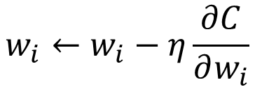

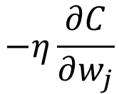
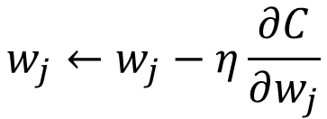
Word Vector – Sharing Parameters
0
z₁
1-of-N encoding
of the word w_{i-2}
w_{i}
1
z₂
The probability for each word as the next word w_{i}
0
……
……
…
w_{j}
0
How to make w_{i} equal to w_{j}
1-of-N encoding
of the word w_{i-1}
Given w_{i} and w_{j} the same initialization
0
1
……
$$w_{i}←w_{i}−η\frac{∂C}{∂w_{i}}$$
$$−η\frac{∂C}{∂w_{j}}$$
$$w_{j}←w_{j}−η\frac{∂C}{∂w_{j}}$$
$$−η\frac{∂C}{∂w_{i}}$$
Notes:
We have talk about this concept in RNN
Should I describe it more clearly?
You can also do avg.
Pointer concept

Slide 15
Word Vector – Various Architectures
Continuous bag of word (CBOW) model
Skip-gram
w_{i-1}
Neural
Network
…… w_{i-1} ____ w_{i+1} ……
w_{i}
w_{i+1}
predicting the word given its context
…… ____ w_{i} ____ ……
Neural
Network
w_{i-1}
w_{i}
w_{i+1}
predicting the context given a word

Slide 16
Beyond 1-of-N encoding
Dimension for “Other”
Word hashing
apple
0
a-a-a
0
bag
0
a-a-b
0
…
…
cat
0
a-p-p
1
dog
0
…
…
…
26 X 26 X 26
elephant
0
p-l-e
1
…
…
p-p-l
1
“other”
1
…
…
w = “apple”
w = “Gandalf”
w = “Sauron”

Slide 17
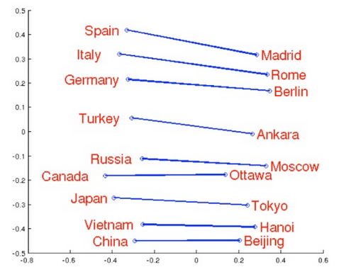
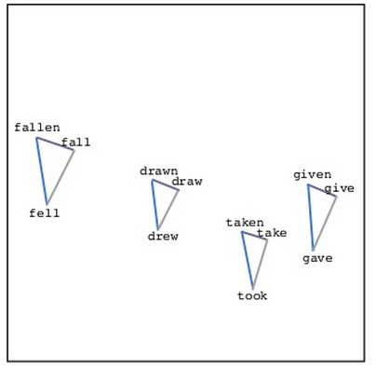
Word Vector
Source: http://www.slideshare.net/hustwj/cikm-keynotenov2014
Notes:
Why can it happen
How to explain it

Slide 18
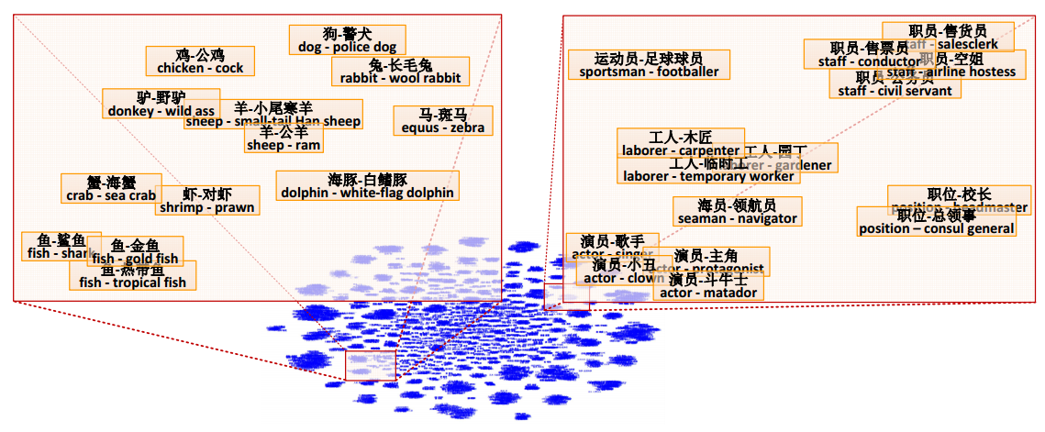
Word Vector
Fu, Ruiji, et al. "Learning semantic hierarchies via word embeddings."Proceedings of the 52th Annual Meeting of the Association for Computational Linguistics: Long Papers. Vol. 1. 2014.

Slide 19
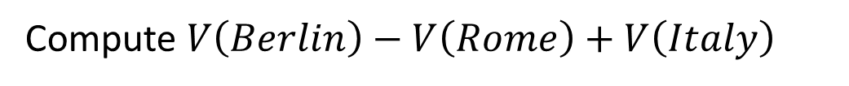
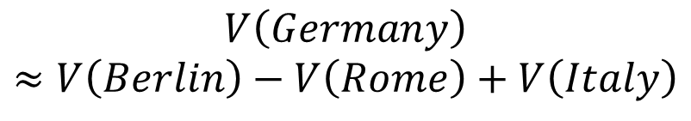
Word Vector
$$V\left(Germany\right)$$
$$≈V\left(Berlin\right)−V\left(Rome\right)+V\left(Italy\right)$$
Characteristics
Solving analogies
$$V\left(hotter\right)−V\left(hot\right)≈V\left(bigger\right)−V\left(big\right)$$
$$V\left(Rome\right)−V\left(Italy\right)≈V\left(Berlin\right)−V\left(Germany\right)$$
$$V\left(king\right)−V\left(queen\right)≈V\left(uncle\right)−V\left(aunt\right)$$
Rome : Italy = Berlin : ?
Compute $V\left(Berlin\right)−V\left(Rome\right)+V\left(Italy\right)$
Find the word w with the closest V(w)
Notes:
Hierarchy is not mentioned …

Slide 20
Demo
Model used in demo is provided by 陳仰德
Part of the project done by 陳仰德、林資偉
TA: 劉元銘
Training data is from PTT (collected by 葉青峰)
Notes:
本魯 廢宅 好棒 好棒棒
魯蛇 窮 溫拿
天 地 溫拿 魯蛇
天 地 專業課
研究生 期刊 漫畫家
找最相近詞: 廢宅 本魯 宅宅 好棒 好棒棒 魯夫 李逍遙 御坂美琴
A:B = C:?
魯夫 海賊王 鳴人
大學生 專題研究 忍者 忍術
大學生 專題研究 漫畫家 作品
天 地 溫拿 魯蛇
天 地 營養學分 專業課
忍者 查克拉 獵人 生命能量
忍者 查克拉 魯夫 橡膠果實
研究生 做實驗 漫畫家
魯夫 海賊王 鳴人
魯蛇 窮 溫拿

Slide 21
Meaning of Word Sequence

Slide 22
Meaning of Word Sequence
word sequences with different lengths → the vector with the same length
The vector representing the meaning of the word sequence
A word sequence can be a document or a paragraph
…
word sequence
(a document or paragraph)
Notes:
The meaning of word is ambiguous
It can be easy for a document

Slide 23
Outline
Deep Structured Semantic Model (DSSM)
Application: Information Retrieval (IR)
Application: Sentiment Analysis, Sentence Relatedness
Unsupervised
Recursive Neural Network
Sequence-to-sequence auto-encoder
Paragraph Vector

Slide 24
Information Retrieval (IR)
Vector Space Model
The documents are vectors in the space.
The query is also a vector.
How to use a vector to represent word sequences
Notes:
How to represent a vector

Slide 25
Information Retrieval (IR)
Bag-of-word
this
1
this
1
is
1
is
1
word string s1:
“This is an apple”
word string s2:
“This is a pen”
a
0
a
1
an
1
…
an
0
…
apple
1
apple
0
pen
0
pen
1
Weighted by IDF
Notes:
idf

Slide 26
Information Retrieval (IR)
Vector Space Model + Bag-of-word
Retrieved
Bag-of-word
Query q
Document d₁
Document d₂
All documents in the database
All the words are treated as discrete tokens.
Never considered: Different words can have the same meaning, and the same word can have different meanings.
Notes:
Of course suffer from the proble mof bag-of-word

Slide 27
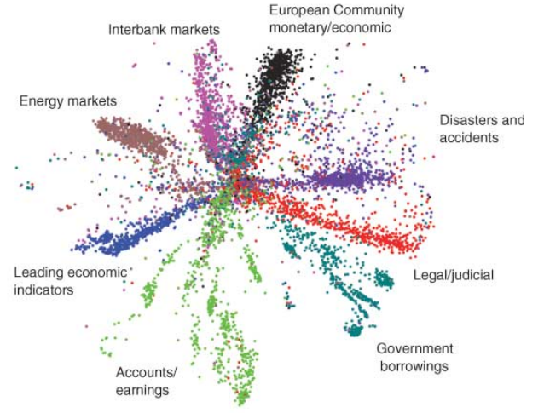
IR - Semantic Embedding
query
Reference: Hinton, Geoffrey E., and Ruslan R. Salakhutdinov. "Reducing the dimensionality of data with neural networks." Science 313.5786 (2006): 504-507
Bag-of-word
word string
(document or query)
How to achieve that? (No target ……)
Notes:
Auto-encoder is another approach
The qeruy not always have the common word

Slide 28

DSSM
Click-through data:
q₁
d₁
: -
: +
d₂
q₂
d₃
: +
: -
d₄
……
Training:
Far apart
close
query q₁
+
document d₁
-
document d₂
Far apart
close
query q₂
document d₃
-
document d₄
+
Notes:
Can apply on new query q’
If we input this query, this document is relevant
They should be on the same meaning
to the same position

Slide 29

DSSM v.s. Typical DNN
Typical DNN
DSSM
reference
query q
+
document d
input
query q
document d
+

Slide 30
Click-through data:
q₁
d₁
: -
: +
d₂
q₂
d₃
: +
: -
d₄
……
How to do retrieval?
Retrieved
New Query q’
Document d₁
Document d₂

Slide 31
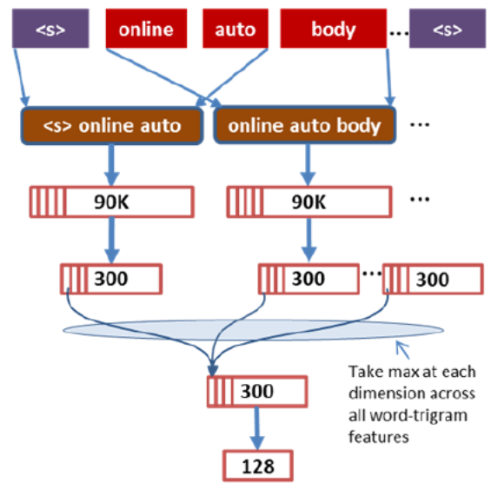
Reference
Huang, Po-Sen, et al. "Learning deep structured semantic models for web search using clickthrough data." ACM, 2013.
Shen, Yelong, et al. "A latent semantic model with convolutional-pooling structure for information retrieval." ACM, 2014.

Slide 32
Outline
Deep Structured Semantic Model (DSSM)
Application: Information Retrieval (IR)
Recursive Neural Network
Application: Sentiment Analysis, Sentence Relatedness
Unsupervised
Paragraph Vector
Sequence-to-sequence auto-encoder

Slide 33
Recursive Deep Model
To understand the meaning of a word sequence, the order of the words can not be ignored.
white blood cells destroying an infection
positive
different
meaning
exactly the same bag-of-word
an infection destroying white blood cells
negative
Notes:
傳染病 infection

Slide 34
Recursive Deep Model
syntactic structure
How to do it is out of the scope
not
very
good
word sequence:
not
very
good
Notes:
Cons$tuency
(phrase
structure)

Slide 35
Recursive Deep Model
syntactic structure
By composing the two meaning, what should the meaning be.
not
very
good
Dimension of word vector = |Z|
Meaning of “very good”
V(“very good”)
Input: 2 X |Z|, output: |Z|
NN
V(“not”)
V(“very”)
V(“good”)
not
very
good
Notes:
Cons$tuency
(phrase
structure)

Slide 36
Recursive Deep Model
syntactic structure
V(w_{A} w_{B}) ≠ V(w_{A}) + V(w_{B})
“not”: neutral
not
very
good
“good”: positive
“not good”: negative
Meaning of “very good”
V(“very good”)
NN
V(“not”)
V(“very”)
V(“good”)
not
very
good
Notes:
Cons$tuency
(phrase
structure)

Slide 37
Recursive Deep Model
syntactic structure
V(w_{A} w_{B}) ≠ V(w_{A}) + V(w_{B})
“棒”: positive
not
very
good
“好棒”: positive
“好棒棒”: negative
Meaning of “very good”
V(“very good”)
NN
V(“not”)
V(“very”)
V(“good”)
not
very
good
Notes:
Cons$tuency
(phrase
structure)

Slide 38
Recursive Deep Model
syntactic structure
“not good”
“not bad”
not
very
good
NN
NN
Meaning of “very good”
“not”
“good”
“not”
“bad”
V(“very good”)
: “reverse” another input
NN
“not”
V(“not”)
V(“very”)
V(“good”)
not
very
good
Notes:
Cons$tuency
(phrase
structure)

Slide 39
Recursive Deep Model
syntactic structure
“very good”
“very bad”
not
very
good
NN
NN
Meaning of “very good”
“very”
“good”
“very”
“bad”
V(“very good”)
: “emphasize” another input
NN
“very”
V(“not”)
V(“very”)
V(“good”)
not
very
good
Notes:
Cons$tuency
(phrase
structure)

Slide 40
The word order is considered.
The representation of the sequence will change if the order of the words are changed
How to train the NN?
V(“not very good”)
What is the target?
NN
V(“very good”)
NN
V(“not”)
V(“very”)
V(“good”)
not
very
good
Notes:
Cons$tuency
(phrase
structure)

Slide 41
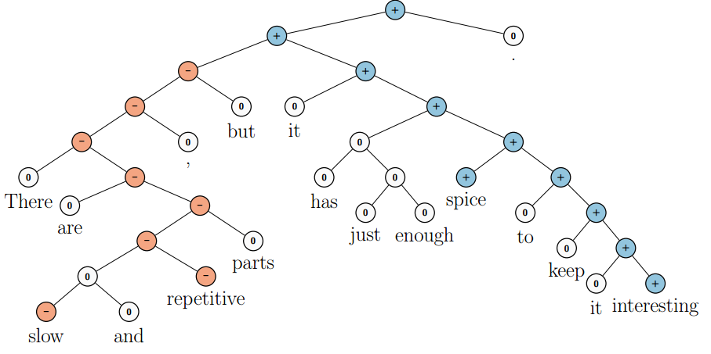
Need a Training Target ……
5-class sentiment classification ( -- , - , 0 , + , ++ )

Slide 42
-
ref
5 classes
( -- , - , 0 , + , ++ )
output
NN
Train both …
NN
NN
NN
NN
V(“not”)
V(“very”)
V(“good”)
not
very
good
Notes:
http://nlp.stanford.edu:8080/sentiment/rntnDemo.html
Cons$tuency
(phrase
structure)

Slide 43
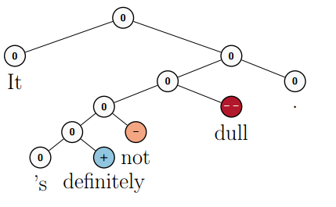
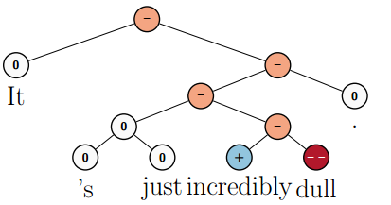
Sentiment Analysis
Socher, Richard, et al. "Recursive deep models for semantic compositionality over a sentiment treebank." Proceedings of the conference on empirical methods in natural language processing (EMNLP). Vol. 1631. 2013.

Slide 44
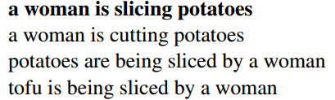

Need a Training Target ……
Sentence relatedness
NN
Tai, Kai Sheng, Richard Socher, and Christopher D. Manning. "Improved semantic representations from tree-structured long short-term memory networks." arXiv preprint arXiv:1503.00075 (2015).
Recursive Neural Network
Recursive Neural Network
Sentence 1
Sentence 2

Slide 45
Outline
Deep Structured Semantic Model (DSSM)
Application: Information Retrieval (IR)
Recursive Neural Network
Application: Sentiment Analysis, Sentence Relatedness
Unsupervised
Paragraph Vector
Sequence-to-sequence auto-encoder
Notes:
google

Slide 46
Neural Network
1-of-N encoding
of word w_{i-2}
W
z₁
x_{i-2}
The probability for each word as the next word w_{i}
z₂
……
1-of-N encoding
of word w_{i-1}
…
W
z
x_{i-1}
z = W ( x_{i-2} + x_{i-1} )
Paragraph d₁:
(The paragraph is from
“The lord of the ring”)
……
……
z = W ( x_{i-2} + x_{i-1} )
魔君
名叫
索倫 (Sauron)
w_{i-2}
w_{i-1}
w_{i}
Same output
Paragraph d₂:
(The paragraph is from “仙五”)
the same
……
魔君
名叫
姜世離
……
z = W ( x_{i-2} + x_{i-1} )
w_{i-2}
w_{i-1}
w_{i}
Notes:
Then error of the prediction can be explained by the meaning of the paragraphs.

Slide 47
Paragraph Vector
1-of-N encoding of paragraph d
Le, Quoc, and Tomas Mikolov. "Distributed Representations of Sentences and Documents.“ ICML, 2014
d₁
1
d₂
0
d₃
0
0
1
0
…
0
…
1
…
1-of-N encoding
of paragraph d
0
W’
……
Original word vector:
z = W ( x_{i-2} + x_{i-1} )
d
Paragraph vector:
z = W ( x_{i-2} + x_{i-1} ) + W’ d
1-of-N encoding
of word w_{i-2}
Neural Network
W
z₁
x_{i-2}
The probability for each word as the next word w_{i}
z₂
……
1-of-N encoding
of word w_{i-1}
…
W
z
x_{i-1}

Slide 48
Paragraph Vector
Original word vector:
z = W ( x_{i-2} + x_{i-1} )
Le, Quoc, and Tomas Mikolov. "Distributed Representations of Sentences and Documents.“ ICML, 2014
Paragraph vector:
z = W ( x_{i-2} + x_{i-1} ) + W’ d
Then error of the prediction can be explained by the meaning of the paragraphs.
Paragraph d₁:
(The paragraph is related to “The lord of the ring”)
……
……
魔君
名叫
索倫 (Sauron)
z = W ( x_{i-2} + x_{i-1} )
w_{i-2}
w_{i-1}
w_{i}
+ W’ d₁
Paragraph d₂:
(The document is related to “仙五”)
different
……
魔君
名叫
姜世離
……
z = W ( x_{i-2} + x_{i-1} )
w_{i-2}
w_{i-1}
w_{i}
+ W’ d₂
Paragraph vector of d:
V(d) = W’ d
Meaning of the paragraph
Notes:
Obtain it in an unsupervised way

Slide 49


Sequence-to-sequence Auto-encoder
Original Auto-encoder
As close as possible
…
…
Layer
Layer
Output Layer
Input Layer
Layer
bottle
Layer
Layer
Layer
Representing the input object
Reference: Hinton, Geoffrey E., and Ruslan R. Salakhutdinov. "Reducing the dimensionality of data with neural networks." Science 313.5786 (2006): 504-507

Slide 50
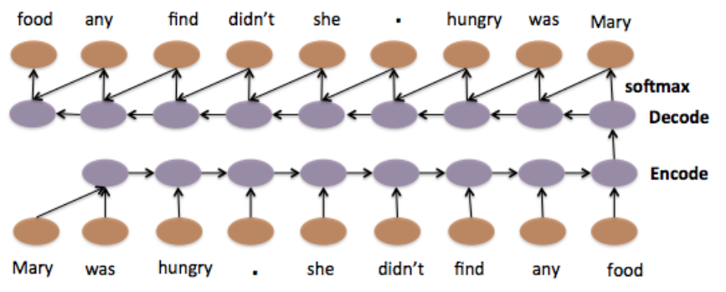
Sequence-to-sequence Auto-encoder
Li, Jiwei, Minh-Thang Luong, and Dan Jurafsky. "A hierarchical neural autoencoder for paragraphs and documents." arXiv preprint arXiv:1506.01057(2015).

Slide 51
Summary
Deep Structured Semantic Model (DSSM)
Application: Information Retrieval (IR)
Recursive Neural Network
Application: Sentiment Analysis, Sentence Relatedness
Unsupervised
Paragraph Vector
Sequence-to-sequence auto-encoder
Notes:
http://naviglinlp.blogspot.tw/2015/03/lecture-1-introduction.html
Chinese Room Experiment and Turing Test mentioned by Charlie in episode 10 of the 4th season of Numb3rs (數字搜查線)
Searle'sChinese Room argument.
In 1980, John Searle conducted an experiment in his counter-argument against Turing’s proposition that a computer has the capability to think for itself. In the Chinese room experiment, an English speaker who does not have the ability to communicate in Mandarin is placed in a room full of Chinese characters (database) and an instruction booklet guiding him step by step on what to do with the characters (program). People situated outside the room are to send in Chinese characters (input) which are actually questions for the English speaker to answer. By following the guidelines according to the instruction booklet, the English speaker would be able to convey the right answers (output) to people outside the room. The program in the room actually passes the Turing Test for ability to understand Mandarin even though it does not.

